Slide 1
WholEUGrain Spring School 2022 Policy instruments and development of on pack communication in the promotion of whole grain intake
29 March 2022 Gabriel Masset
Food Policy working group

Slide 2
Promoting whole grain – which policies?
Science
Which policy instruments ?
Help individuals identifying food products with more whole grain?
Incentivize food producers to include more whole grain in their offering?
Science-based
Easily implemented in regulations
Regulators
Food Industry
Consumers

Slide 3
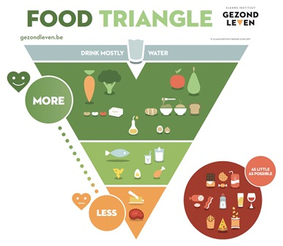
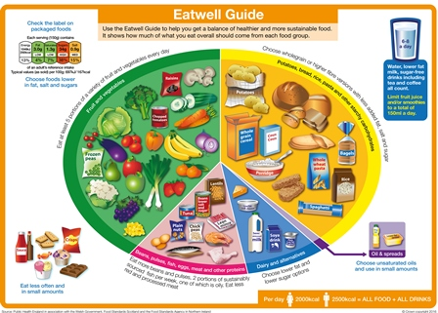
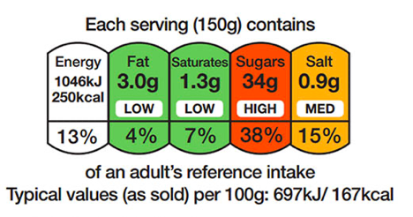
Which policy instruments?
Dietary Guidelines
Education and Campaigns
Front-of-Pack labels
Claims
Taxes / incentives
Reformulation

Slide 4
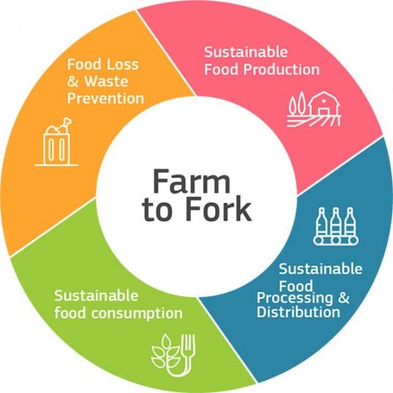
Front-of-Pack labeling (FOPL)
Policy tool widely implemented and accepted by many stakeholders
Some FOPL schemes already include whole grain (→ it is feasible)
European Commission to propose Pan-EU system in Q4 2022 (Farm to Fork strategy)
→ Ensure coherent messaging to individuals, i.e. recognition of whole grain content in food products – in line with dietary guidelines
Drewnowski et al. 2021 doi.org/10.1093/advances/nmaa172

Slide 5
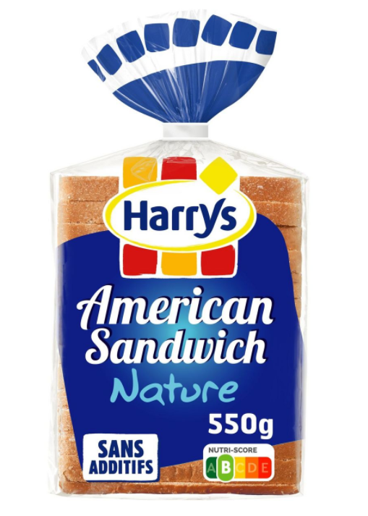
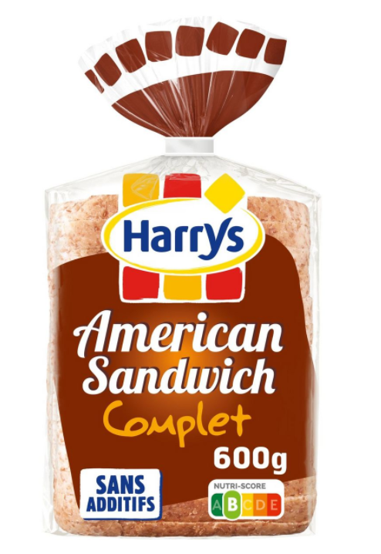
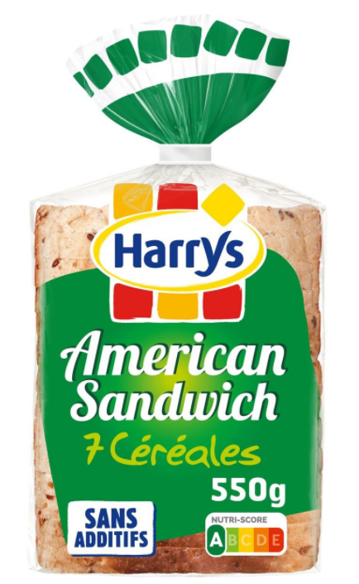
The example of Nutri-Score
Based on UK Nutrient Profile model
Supported by 7 European countries
Implemented by several food manufacturers
Understood by consumers
→ potential EU-Wide system
→ Higher whole grain content not recognized
→ Possible consumer confusion & lack of incentive for manufacturers
Source: auchan.fr (24.3.2022)

Slide 6
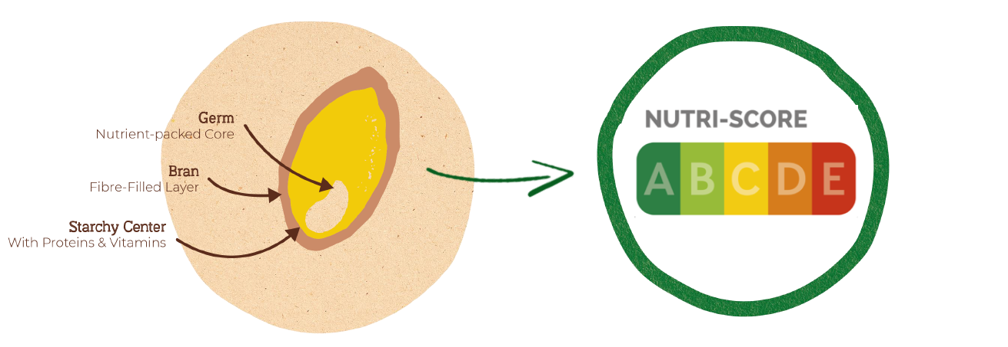
Nutri score – suggested modifications
Whole grain scoring
Components to Increase (3 x 5 pts)
Fruit, vegetables, pulses, nuts, rapeseed/walnut & olive oil
Protein
Fibre
Score | 0 | 1 | 2 | 3 | 4 | 5
WG% (dry weight) | <25 | 25 |  | 50 |  | 100
Nutrients to Limit
(4 x 10 pts)
Energy
Sugars
Saturated Fat
Sodium
Modification leads to higher associations with dietary guidelines
Kissock et al. 2022 DOI:10.1007/s00394-021-02718-6

Slide 7
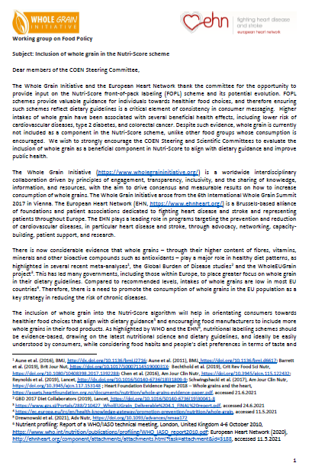
Advocacy results & next steps ?
What we’ve achieved
Our request for the recognition of WG has been received and acknowledged as important
Next steps
Continued engagement with EUR stakeholders
JAN 2021
Feedback to EUR CONSULTATION
JUN 2021
Formal request to include WG in algorithm
Q3 2021
Open letter to EC, endorsed by many NGOs and MEPs
Q1 2022
Feedback to EFSA and EC public consultations
Q2-3 2022
WGI ACTIONS:
EC Consultations on Sustainable Food Systems and the EU F&V School Scheme
Open letter to EFSA for defining WG quantitative recommendations
Position statement ‘Why is whole grain more than fibre?’
Engaging with MEPs
External development
EFSA position on FOPL and nutrient profiles
Nutri-Score revised algorithm
Q4 2022
EC to propose harmonized mandatoy FOPL & nutrient profiles
Whole Grain topic identified as key
→ Scientific Committee to work on it.
EC replied positively
→ Continue engaging through consultations

Slide 8
Conclusion
The Whole Grain Initiative believes FOPL can be an effective & complementary instrument to promote whole grain
Coherence with dietary guidelines
Easily understood by consumers
Visible changes for manufacturers
So what’s missing to make it happen?
Engagement with stakeholders & policy makers
Sharing the whole grain definitions adopted by the Whole Grain Initiative
Recommended levels of intake

Slide 9
Thank You!
Food Policy working group
Contact:
Gabriel Masset
Gabriel.masset@nestle.com

Slide 10
Background & regulatory context
↗ whole grain consumption ↔ improved health outcomes
Whole Grain consistently promoted in dietary guidelines
People are not reaching recommended levels of intake
Which policy tool to:
Help individuals identifying food products with more whole grain?
Incentivize food producers to include more whole grain in their offering?
European regulatory context
Farm to Fork strategy
Objective: propose pan-EU nutritional Front-of-Pack Labeling scheme

Slide 11
FOP schemes including whole grain (Example criteria for breakfast cereals)
Singapore – Healthy Choice scheme. Min 25% WG (and 4g fibre/100g)
Malaysia – Healthy Choice scheme. Min 25% WG (and 6g fibre/100g)
Nordic Keyhole. Min 55% WG (and 6g fibre/100g)
Danish Whole Grain Partnership. Min 65% WG (and 6g fibre/100g)
US Whole Grain Stamp. 3 levels (9g WG per serve, 50% WG, 100% WG)

Slide 12
- VISION & MISSION
Whole Grain Summit 2017 ⤇ VIENNA WHOLE GRAIN DECLARATION
experts’ consensus on the principal goals
actions that must be taken to increase whole grain intake
cooperation in a global “Whole Grain Initiative” with international working groups
Whole Grain Initiative’s VISION:
To globally increase whole grain intake.
Whole Grain Initiative’s MISSION:
World-wide interdisciplinary collaboration driven by principles of
engagement,
sharing knowledge, information and resources,
transparency and inclusivity
to increase the whole grain intake worldwide.
To act as overarching independent counterpart for policy makers and donor organisations.

Slide 13
- ACTIVITIES / Working Groups
International Working Group on Whole Grain Definitions
Aims: Reach consensus on a global definition of whole grain raw materials
Reach consensus on a whole grain food definition
Chair: Jan Willem van der Kamp / TNO
International Working Group on Economic Evaluation of Increased Whole Grain Intake
Aims: Give insight into the economic impact of whole grains and health care costs relative to increasing whole grain consumption beyond current levels
Chair: Jan de Vries / Nutrition Solutions
International Working Group on Best Practices for Public-Private Partnerships & Communication
Aims: Create cohesive and consistent messaging and strategies around the promotion of whole grains to help capture consumer attention
Provide a framework that can be used in communities/countries/regions around the globe to form public-private partnerships
Chair: Abby Clement / WGC
International Working Group on Sustainability of Whole Grains
Aims: Develop data that will clarify the role that cereal grains might play in promoting the most sustainable food supply.
Evaluate the whole grain supply chain to build a holistic understanding of whole grain sustainability.
Chair: Keagan Ringling / University of Minnesota

Slide 14
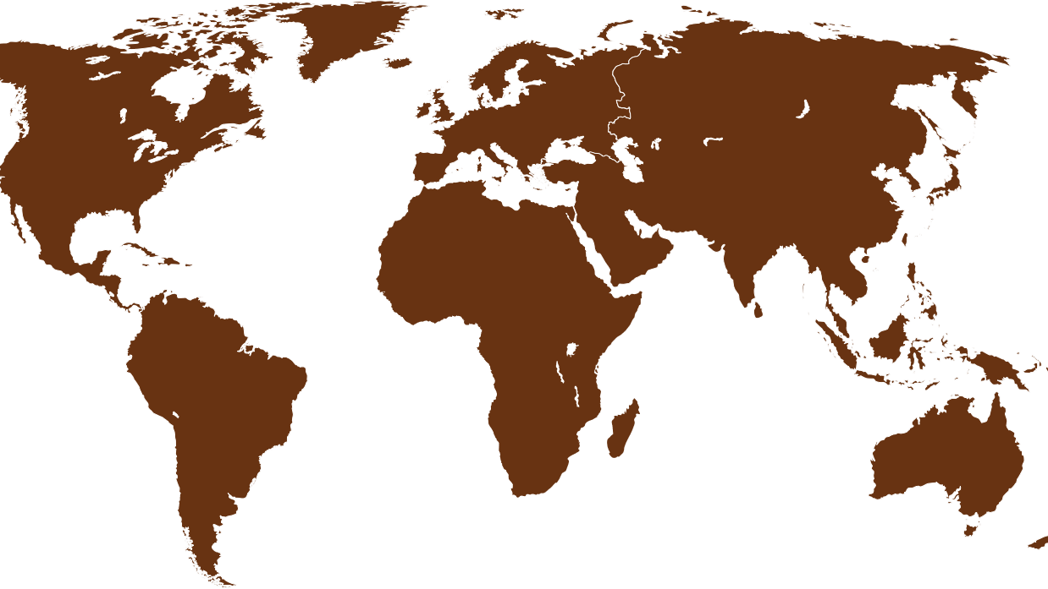
- PARTNERS so far
AEGIC, AU
Biogranum, SR
Bread Institute, SE
Bühler AG, CH
Chinese Cereal & Oil Association, CN
CEEREAL, BE
Cereal and Grains Association (AACCI), USA
Chinese Grain Product Research Development Institute, CN
CIAD – Research Center in Food & Development , MX
CIMMYT - International Maize & Wheat Improvement Center, MX
Cereal Partners Worldwide, CH
Fazer Ab (Oy Karl Fazer Ab), FI
GoodMills, DE
Grains & Legumes Nutrition Council, AU
HealthGrain Forum, FI
Henan University of Technology, CN
ICC – International Association for Cereal Science & Technology, AT
Institute of Agricultural Resources and Economics, LV
Institute of Agrochemistry and Food Technology (Spanish National Research Council) IATA, ES
International Hellenic University - Department of Food Science and Technology, GR
ISEKI Food Association, AT
Istinye University, TR
Lantmännen, FI
Latvia University of Life Sciences and Technology, LV
Morning Foods Ltd, UK
NABIM, UK
National Engineering Technology Research Center for Grain Processing Equipment, CN
National Scientific and Technical Research Council, AR
Nutrition Solutions, NL
Oldways Whole Grains Council, US
Open Fields srl, IT
Patroba, BE
Procerealtech (University of Valladolid), ES
Staple Food Industries Sdn. Bhd., MY
Swedish Association of Bakers & Confectioners, SE
Swedish University of Agricultural Sciences - Department of Molecular Sciences, SE
University of Bologna - Life Sciences and Bioeconomy Unit, IT
University of Minnesota - Department for Food Science and Nutrition, USA
University of Pretoria, ZA
University of Zagreb, Faculty of Food Technology and Biotechnology, HR
VTT, FI
Wageningen University & Research, NL
Notes:
Governing Committee - Role and Responsibilities:
Determination of the overall mission/vision of the WGI
External facing team to represent WGI and engage with Governments, NGOs
Solicit partnerships with Governments, NGOs
Recruit new partners
Formal dissemination (e.g. conferences) of WGI mission/vision and activities (in collaboration with working group team leads)
Authorisation of final Working Group Output incl. coordination of the publication thereof
Responsible to have every 3 years a Whole Grain Summit
Authorisation and initiation of new WGI Working Groups with a specified goal
Select one “Representative/President” according to some rotation mechanisms (which still needs to be determined)
Pull the Industry and Consumer Forum together
Scientific Committee - Role and Responsibilities:
Provide (requested and unrequested) advise to the GC as well as to the Working Groups
Help working groups to overcome barriers
Check requests for future working groups and bring that forward to the Governing Committee
Ask actively for input from the Industry and Consumer Forum
Working Groups - Role and Responsibilities:
Identification and documentation of the detailed objective, goals, strategies and metrics (OGSM)
Identify and reach out to experts as needed (incl. invitation to join efforts)
Execute projects, draft data
Develop manuscripts or locate funding to out-source the writing of manuscripts
Communication of working group activities (e.g. orals or abstracts at conferences)
Put forward the final working group output to the Governing Committee for confirmation
Setting up calls and meetings (internal organisation)
Regular communication to update the Governing Committee
Report Output to the Whole Grain Summit

